Slide 1




PDS
Introduction to Linux
Computer Vision
https://github.com/siagianp
https://www.youtube.com/@AmelOline/videos
https://github.com/amelcharolinesgn2/Cloud-Infrastructures
https://github.com/amelcharolinesgn2/ClouD-Infrastructure-SISKA-2025
https://github.com/amelcharolinesgn2/CCNA1
https://github.com/amelcharolinesgn2/CCNA2
https://github.com/amelcharolinesgn2/AWS Certificate
Notes:
Lab Session 01: AWS Compute Foundations – EC2, Networking, and Application Deployment Lab Session 02: Identity and Access Control with IAM Lab Session 03: Cloud Storage Solutions – S3, EBS, and EFS Lab Session 04: Database Services – RDS, DynamoDB, and ElastiCache Lab Session 05: Load Balancing and Auto Scaling Lab Session 06: Container Orchestration with ECS, Fargate, and EKS Lab Session 07: Serverless Computing with Lambda Lab Session 08: Monitoring, Logging, and Security Auditing Lab Session 09: Infrastructure as Code – CloudFormation, CDK, and Terraform Lab Session 10: CI/CD Pipelines – App Runner, CodePipeline, GitHub Actions, and CodeDeploy Lab Session 11: AI/ML Services – Rekognition, Comprehend, Translate, and SageMaker Lab Session 12: Hybrid Cloud Networking – VPC Peering, Transit Gateway, VPN, and Direct Connect Lab Session 13: Security and Compliance – AWS Config, GuardDuty, Security Hub, and KMS Lab Session 14: Disaster Recovery and Business Continuity – AWS Backup, Multi-Region, and Failover Lab Session 15: Migration and Modernization – DataSync, DMS, MGN, Containers, and Serverless
Lab Session 16: Cost Management and Optimization – Cost Explorer, Trusted Advisor, Budgets, and Well-Architected
https://www.youtube.com/watch?v=SOTamWNgDKc&t=19604s

Slide 2
Introduction to Linux
Exploring the Foundation of Open Source Operating Systems

Slide 3
What is Linux?
Linux is an open-source and Unix*-like operating system.
Created by Linus Torvalds in 1991.
Used in diverse fields: Servers, desktops, embedded systems, and more.
Key Point: Linux powers over 90% of servers on the internet.
*UNIX is a multi-user, multitasking operating system (OS) that was developed in the late 1960s by Bell Laboratories at AT&T

Slide 4
Brief History of Linux
Unix (1969): Inspiration for Linux.
GNU Project (1983): Free software foundation started by Richard Stallman.
1991: Linus Torvalds announced Linux Kernel.
Open Source Revolution: Collaboration among developers worldwide.

Slide 5
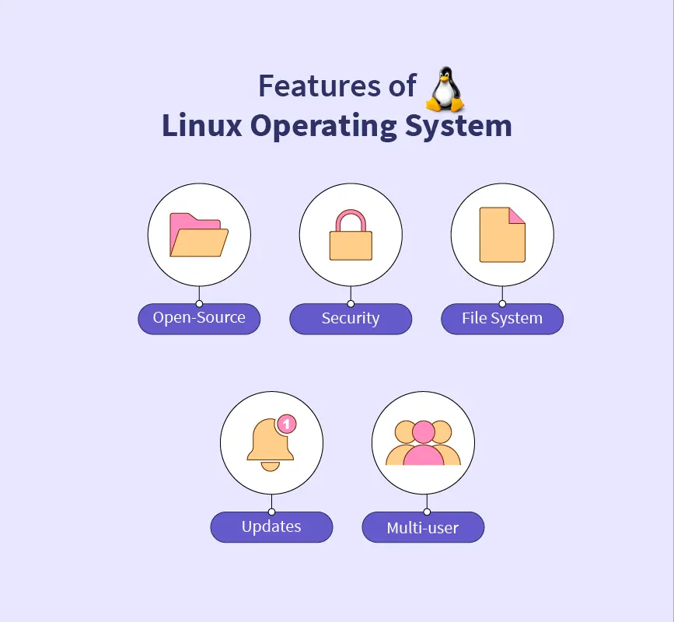
Core Features of Linux
Open Source: Freely available and customizable.
Multiuser Support: Many users can work simultaneously.
Portability: Runs on a wide range of hardware.
Security: Built-in user and process isolation.
Stability: Reliable for long-term use.

Slide 6
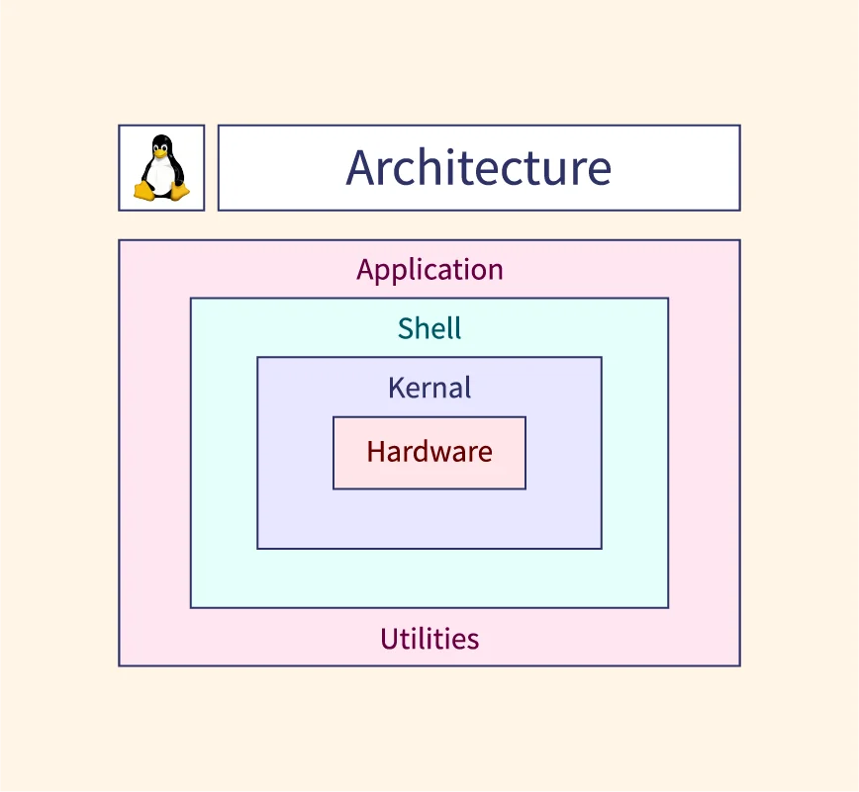
Linux Architecture
Hardware: Physical components of the computer.
Kernel: The core that interacts with hardware.
System Libraries: Provide essential functionality.
Shell: Command-line interface for user interaction.
Applications: Software running on top of the OS.

Slide 7
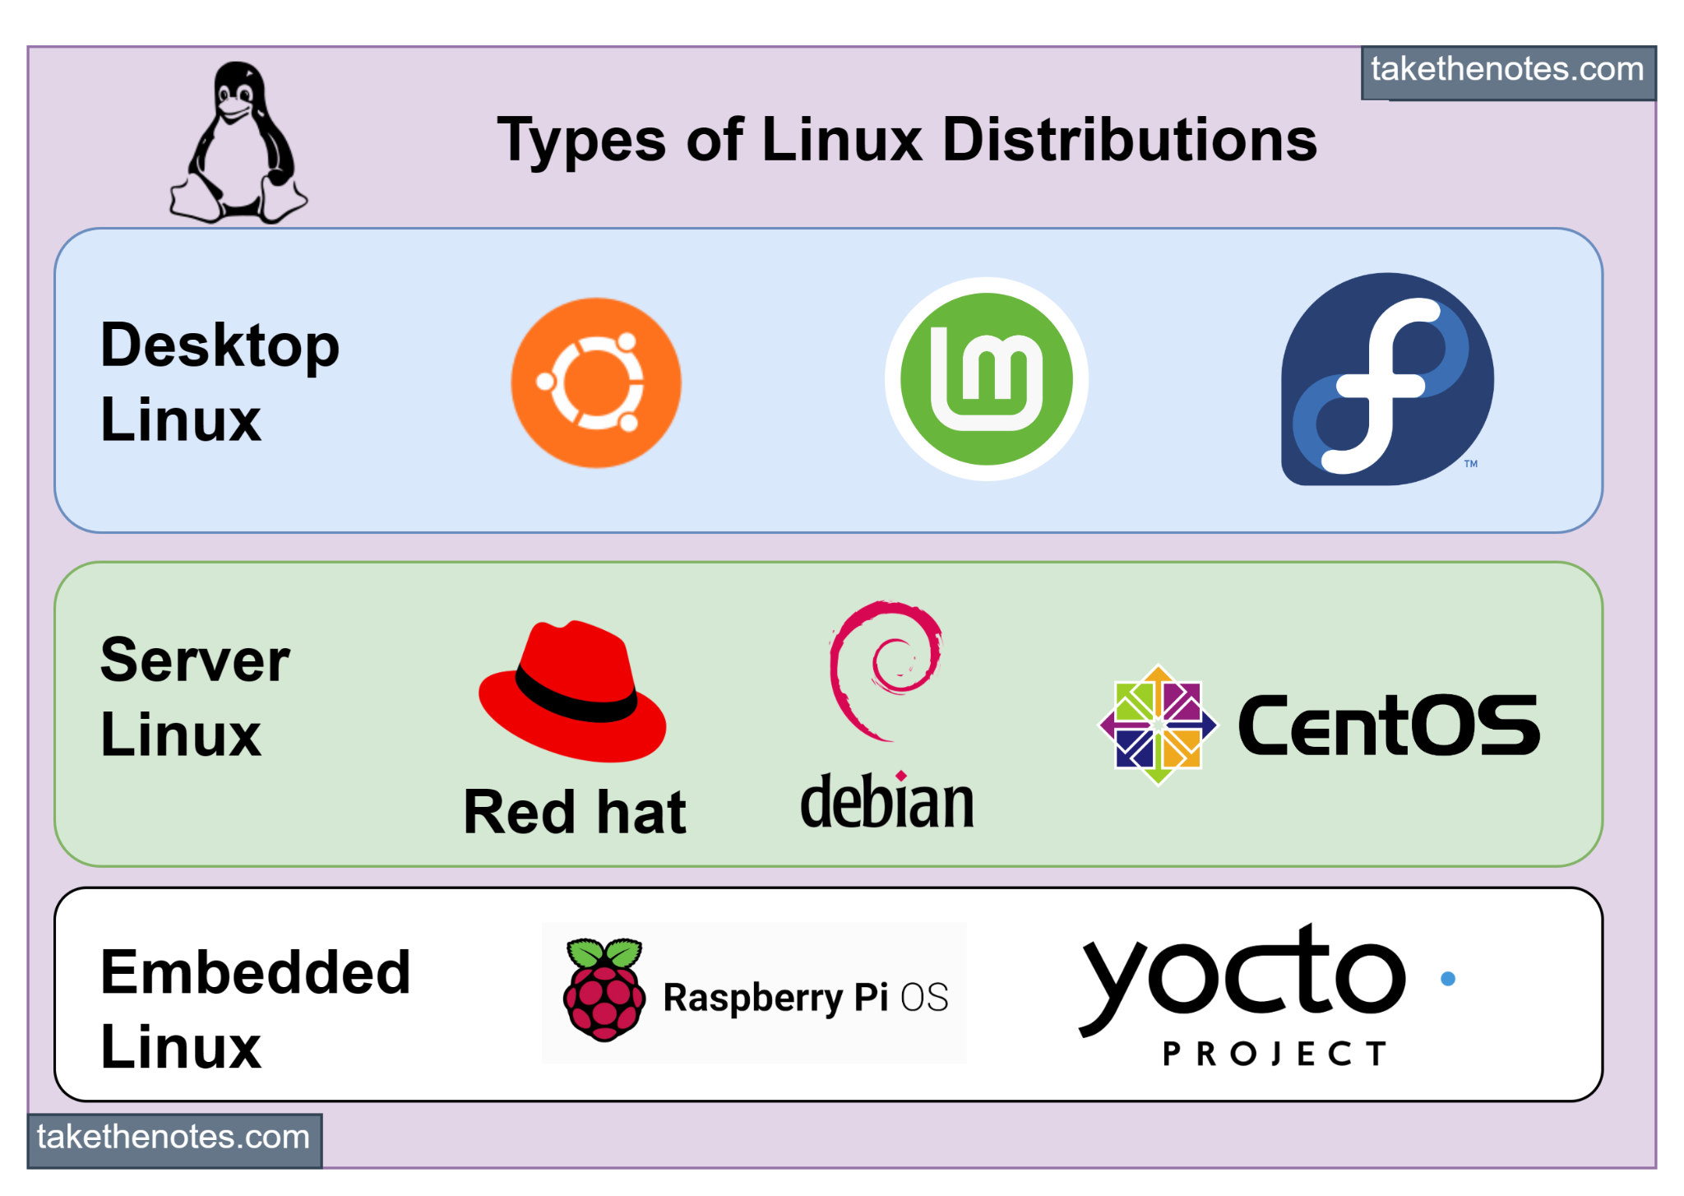
Linux Distributions
What is a Distribution?
A collection of the Linux kernel, software packages, and tools.
Popular Distributions:
Ubuntu: User-friendly.
Fedora: Cutting-edge software.
Debian: Stability and reliability.
Arch Linux: Customizable and minimalistic.
Specialized lightweight distros:
Tiny Core Linux (~16 MB)
Puppy Linux (~300 MB)

Slide 8
Why Choose Lightweight Linux Distros?
Designed for systems with low RAM and storage.
Suitable for:
Old computers
Embedded systems
Minimalistic environments
Examples:
Tiny Core Linux: ~16 MB
Damn Small Linux: ~50 MB
AntiX: ~400 MB
Bodhi Linux: ~700 MB

Slide 9
Basic Linux Commands
Navigating the File System:
ls: List files.
cd: Change directory.
pwd: Print working directory.
File Management:
mkdir: Create a directory.
rm: Remove a file or directory.
cp: Copy files.
System Monitoring:
top: View running processes.
df -h: Check disk usage.
free -m: Check memory usage.

Slide 10
Real-World Applications of Linux
Web Servers: Powering Google, Facebook, and Twitter.
Supercomputers: Runs on 100% of the world’s top 500 supercomputers.
IoT Devices: Used in smart devices and embedded systems.
Programming: Preferred platform for developers due to robust tools.
Gaming: Platforms like SteamOS bring gaming to Linux.

Slide 11
Linux Desktop Environments
GNOME: Modern and simple.
KDE Plasma: Highly customizable.
XFCE: Lightweight and fast.
LXQt: Minimal resource usage.
Mate: Traditional desktop feel.

Slide 12
Myths and Misconceptions
"Linux is hard to use" → Modern distros are beginner-friendly.
"No software is available" → Vast libraries of applications.
"Only experts use Linux" → Distros like Ubuntu and Linux Mint are for everyone.

Slide 13
Advantages of Linux
Cost: Free to use.
Customizability: Tailor it to your needs.
Performance: Runs efficiently on all hardware.
Security: Resilient against malware and viruses.
Community: Active global support.

Slide 14
Challenges of Linux
Learning curve for beginners.
Software compatibility: Some proprietary software may not run.
Hardware drivers: Rare cases of unsupported hardware.

Slide 15
Conclusion
Linux is a versatile, secure, and open-source OS.
Powers much of today’s technology and infrastructure.
Encouragement: Start small, experiment with a lightweight distro.
“The Linux community is always there to support you.”

Slide 16
THANK YOU
Amel charoline
Amel Online & Irene magdalena
https://github.com/siagianp
https://www.youtube.com/@AmelOline/videos
https://github.com/amelcharolinesgn2/Cloud-Infrastructures
https://github.com/amelcharolinesgn2/ClouD-Infrastructure-SISKA-2025
https://github.com/amelcharolinesgn2/CCNA1
https://github.com/amelcharolinesgn2/CCNA2
https://github.com/amelcharolinesgn2/AWS Certificate

